Slide 1
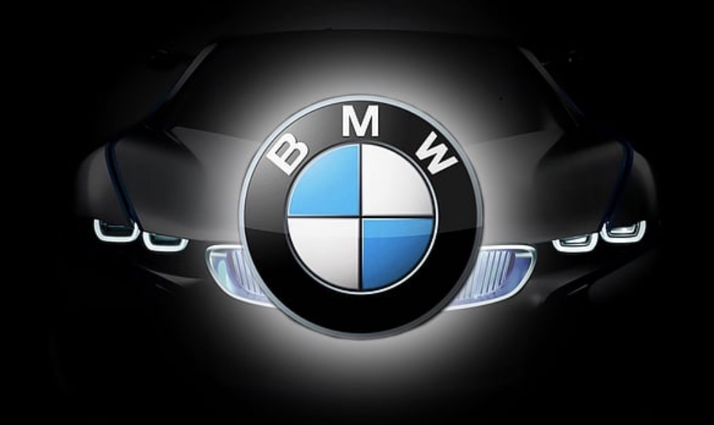
Yarmouk University
Faculty of Computer Science and Information Technology
BMW Sales Analysis
Course: DA 460 — Data Visualization | Instructor: Dr. Zeyad Hailat

Slide 2
Team Members
DA 460 — Data Visualization | Dr. Zeyad Hailat
1
Jocelyn Nidal Al-Rabadi
2
Sara Mohammad Al-Zreigat
University ID: 2023805011
University ID: 2023905085
3
Suwar Mohammad Othman
4
Jumana Ammar Obaidat
University ID: 2022905045
University ID: 2022905020
BMW Sales Analysis | Yarmouk University | 2025

Slide 3
Dataset Overview
Source, coverage, and structure of the BMW Sales dataset
Dataset Name
Key Variables
BMW Sales 2010–2024
▸ Model (3 Series, 5 Series, 7 Series, i3, i8, M3, M5, X1, X3, X5, X6)
Platform
Kaggle
▸ Year (2010–2024)
▸ Price (USD)
Author
y0ussefkandil
▸ Fuel Type (Hybrid, Petrol, Electric, Diesel)
Coverage
▸ Transmission (Automatic, Manual)
2010 – 2024 (15 years)
▸ Color (Blue, White, Black, Red, Silver, Grey)
Format
▸ Mileage (KM)
CSV
▸ Sales Volume & Region (Asia, Europe, North America, Middle East, Africa, South America)
BMW Sales Analysis | Yarmouk University | 2025

Slide 4
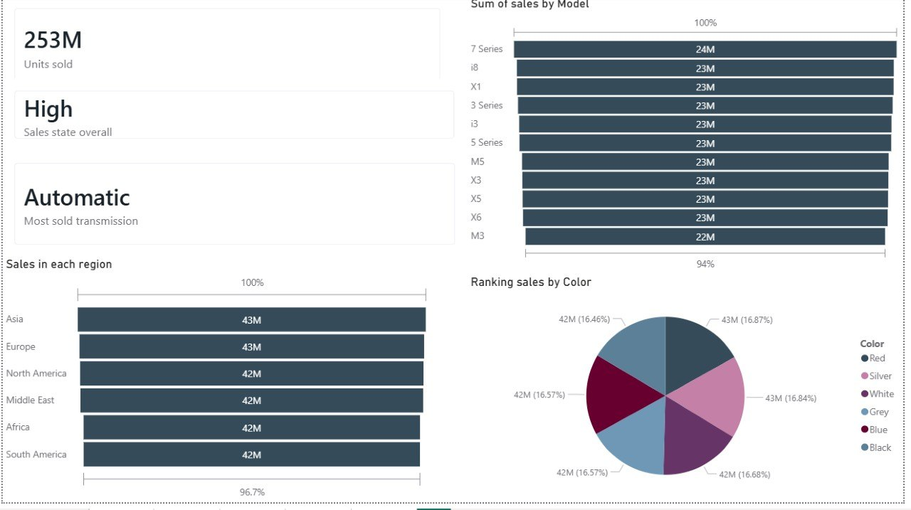
Overview — KPIs
Key Performance Indicators — Overview Page
253M
High
Automatic
Asia
Total Units Sold
Overall Sales State
Top Transmission
Top Region
All Models 2010–2024
Classified as High
Most Sold Type
43M units — Leading
BMW Sales Analysis | Yarmouk University | 2025

Slide 5
Sales Distribution by Model
Total sales volume and sales classification (High/Low) by vehicle model
7 Series Leads
Highest total sales across all years (24M units combined)
Consistent Gap
High vs. Low classification shows minimal spread across all models
Electric Models
i3 and i8 rank among top 5 despite premium pricing
X-Series Strong
X1, X3, X5, X6 collectively dominate the SUV segment
BMW Sales Analysis | Yarmouk University | 2025

Slide 6
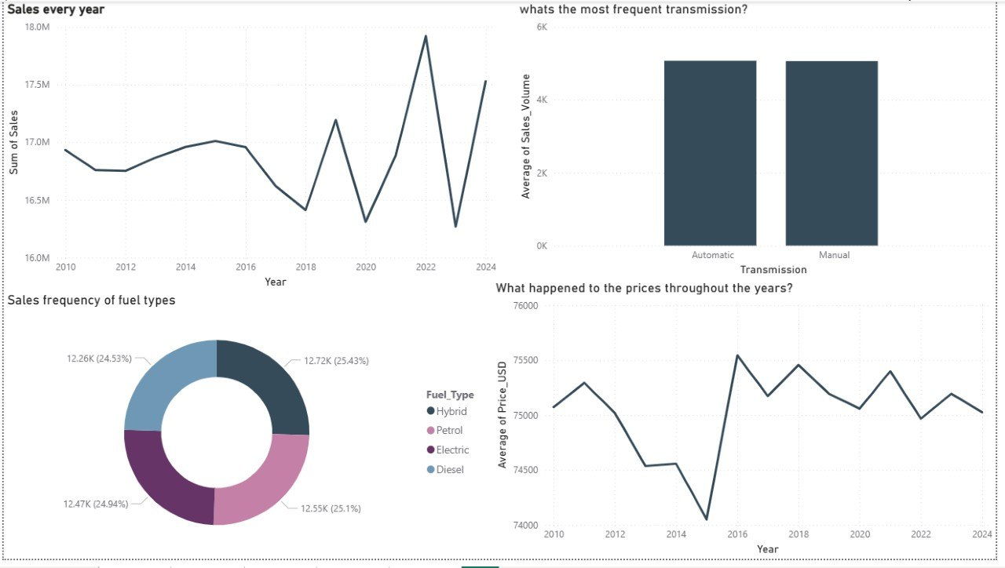
Price, Color & Fuel Type Analysis
Average pricing by color, fuel type distribution, and mileage correlation
Price by Color: All colors avg ~$75K — minimal variation | Fuel Distribution: Hybrid leads, followed closely by Petrol, Electric, Diesel
BMW Sales Analysis | Yarmouk University | 2025

Slide 7
Regional Sales & Transmission
Sales breakdown by global region and transmission type preferences
Asia Top Region
All 6 regions nearly equal (~618–639M).
Asia leads with 639M units sold.
BMW Sales Analysis | Yarmouk University | 2025

Slide 8
Yearly Sales & Price Trends
Annual performance from 2010 to 2024 — volume and average pricing over time
BMW Sales Analysis | Yarmouk University | 2025

Slide 9
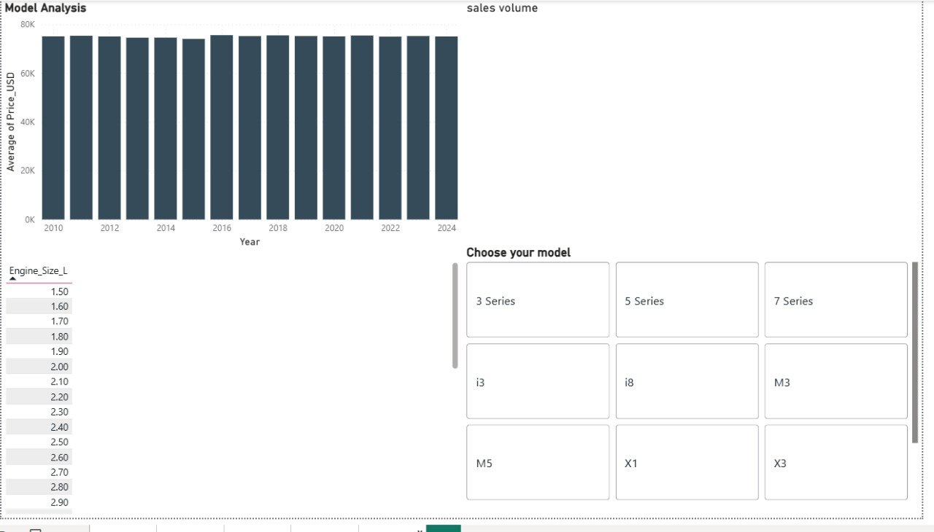
Model Deep Dive — Interactive Analysis
Per-model price trends, engine size filter, and sales volume — Power BI interactive page
3 Series
5 Series
7 Series
i3
i8
M3
M5
X1
X3
BMW Sales Analysis | Yarmouk University | 2025

Slide 10
Key Findings & Conclusion
Summary of insights from the BMW Sales 2010–2024 dataset
Stable Pricing
7 Series Dominates
Average BMW price remains steady at ~$74K–$75.5K across all models and years, reflecting premium brand consistency.
The 7 Series leads all models in total sales (24M units), followed closely by i8 and X1 at 23M each.
Balanced Global Reach
Transmission Split
All 6 regions show near-equal sales (618M–639M), with Asia at the top — demonstrating BMW's truly global appeal.
Automatic (50.09%) narrowly edges out Manual (49.91%) — both transmission types remain highly popular.
Diverse Fuel Types
Sales Peak 2022
All four fuel types (Hybrid, Petrol, Electric, Diesel) hold approximately equal market share (~25% each).
Annual sales peaked around 2022 at ~17.9M units before normalizing, indicating post-pandemic demand surge.
Thank you | BMW Sales Analysis | Yarmouk University | DA 460

